Slide 1
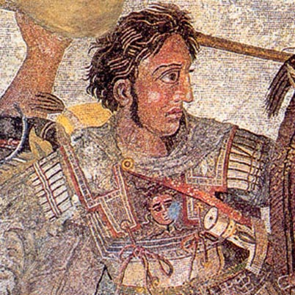
Alexander ‘the Great’
Became king of Macedonia in 336 BCE
Invaded the Achaemenid Empire, and defeated its last king in 330 BCE
Died at Babylon in 323 BCE

Slide 2
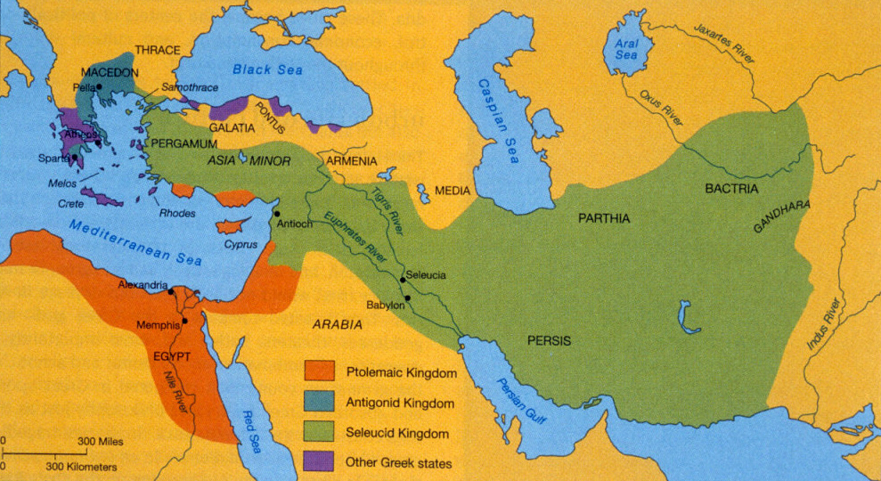
The Hellenistic World

Slide 3
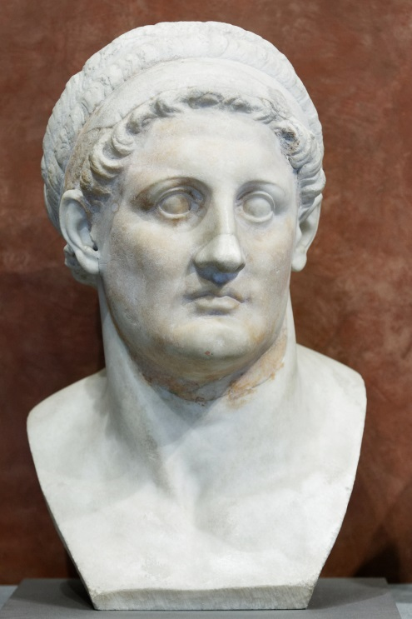
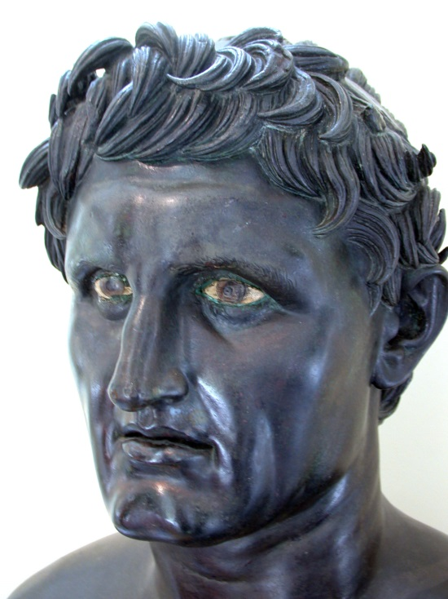
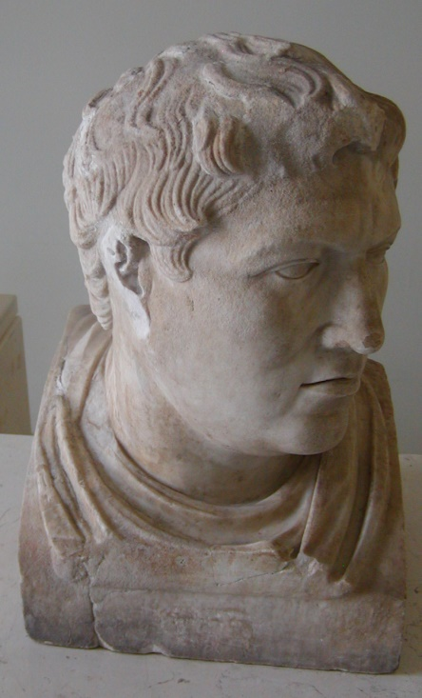
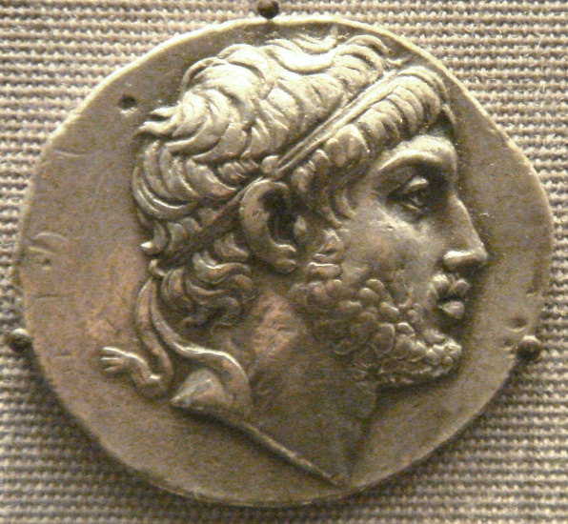
Hellenistic Kingdoms
Ptolemaic Kingdom
(Egypt)
Seleucid Empire
(Middle East)
Antigonids
(Macedonia)
Attalids
(Western Turkey)
Kings named ‘Ptolemy’
Kings named ‘Seleucus’ and ‘Antiochus’
Kings named ‘Philip’ and other things
Kings named ‘Eumenes’ and ‘Attalus’

Slide 4
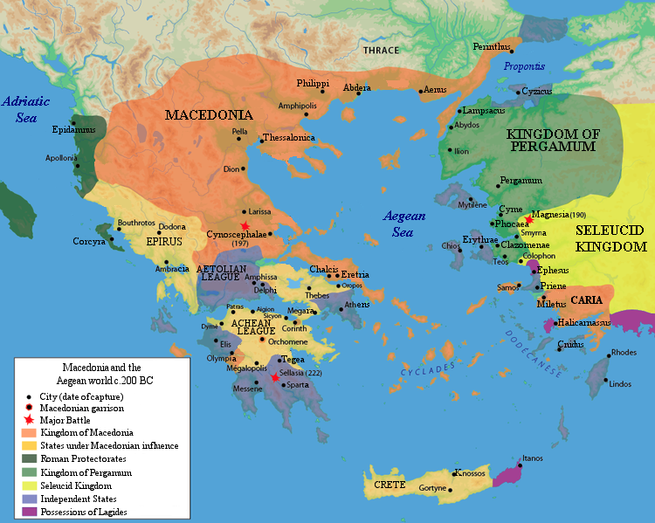
Hellenistic Leagues, Poleis, etc.
Aetolian League
Achaean League
Sparta
Rhodes
Illyrian pirates

Slide 5
Illyrian Pirates
Tribes living in Illyria on the eastern coast of the Adriatic
Engaged in piracy against Italian merchants and Greek colonists
Regarded by the Antigonids as a Macedonian sphere of influence
Romans attacked Illyrians in 229 and 219 BCE

Slide 6

Philip V of Macedonia
c. 238-179 BCE
Becomes king in 221 BCE
Allied with Carthage during the Second Punic War

Slide 7
First Macedonian War
Treaty between Philip and Carthage in 215 BCE (i.e. during Second Punic War)
Rome responds by allying with the Aetolian League in 212/211 BCE
Ends in stalemate in 205 BCE

Slide 8
Second Macedonian War
Philip forms an alliance with the Seleucid king Antiochus III to seize Ptolemaic territories
Egypt and some Greek cities ask Rome for help; Rome intervenes in 200 BCE
Romans under Titus Quinctius Flamininus defeat Philip at Cynoscephalae in 197 BCE

Slide 9
The Battle of Cynoscephalae (197 bce)
“With his right wing, then, Philip had the advantage, since from higher ground he threw his entire phalanx upon the Romans, who could not withstand the weight of its interlocking shields and the sharpness of its projecting pikes; but his left wing was broken up and scattered along the hills, and Titus, despairing of his defeated wing, rode swiftly along to the other, and with it fell upon the Macedonians. These were unable to hold their phalanx together and maintain the depth of its formation (which was the main source of their strength), being prevented by the roughness and irregularity of the ground, while for fighting man to man they had armor which was too cumbersome and heavy. For the phalanx is like an animal of invincible strength as long as it is one body and can keep its shields locked together in a single formation; but when it has been broken up into its parts, each of its fighting men loses also his individual force, as well because of the manner in which he is armed as because his strength lies in the mutual support of the parts of the whole body rather than in himself.”
- Plutarch, Life of Flamininus 8

Slide 10
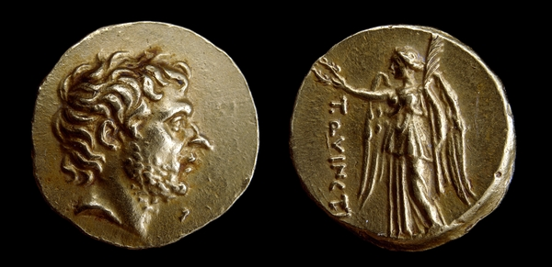
Titus Quinctius Flamininus
*
c. 228-174 BCE
Military tribune in 208
Quaestor in 206
Elected consul in 198
Defeated Philip at Cynoscephalae in 197
Proclaimed the ‘freedom of the Greeks’ at the Isthmian Games in 196
Gold stater, Macedonia, c. 196 BCE; obv.: head of T. Quinctius r.; rev.: Nike standing l., holding laurel crown; legend: T. QUINCTI[us]

Slide 11
The Freedom of the Greeks
“The Roman senate and Titus Quinctius consul, having defeated King Philip and the Macedonians, release as free, without garrisons, subject to no tribute and in the enjoyment of their ancestral laws [the following peoples]: the Corinthians, Phocians, Locrians, Euboeans, Phthiotic Achaeans, Magnesians, Thessalians, and Perrhaebians.”
- Polybius 18.46.5
*

Slide 12
War with the Seleucids
Invaded Greece in 192 BCE; defeated by the Romans in 191
Romans invaded Asia Minor and defeated the Seleucids again in 188
In the Peace of Apamea (188), the Romans give large tracts of Seleucid territory to Pergamum

Slide 13
King Perseus of Macedonia
c. 213-165 BCE
Eldest son of Philip V, whom he succeeded as king in 179
Cancelled debts and recalled exiles
Rome declared war in 172
Defeated by the Romans at Pydna in 168 BCE
Macedonian divided in four separate republics

Slide 14
Antiochus IV in Egypt (168 bce)
“When Antiochus had advanced against Ptolemy in order to take control of Pelusium, he was met by the Roman commander Popilius. The king greeted him by voice from a distance and offered to him his right hand, but Popilius presented to him the tablet he had in his hand which contained the Senate’s decree, and asked Antiochus to read it first…When the king had read it, he said he wanted to consult with his friends on these new developments, but Popilius in reply did something which seemed insolent and arrogant to the highest degree. With a vine stick he which he had in his hand he drew a circle around Antiochus and told him to give his reply to the message before he stepped out of that circle. The king was astounded at this arrogance and after hesitating for a moment said he would do everything the Romans asked from him.”
- Polybius 29.27

Slide 15
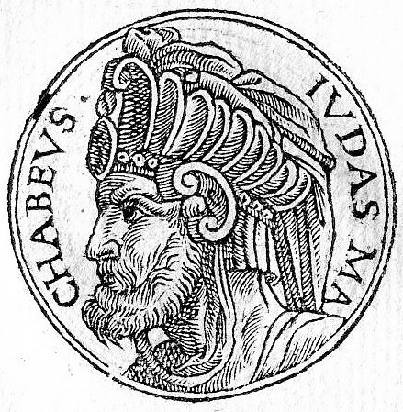
The Maccabean Revolt
Seleucids found a temple of Zeus in Jerusalem in 168 BCE
High priest Judas Maccabaeus (‘the Hammer’) revolts in 166
Defeats the Seleucids and restores the temple in Jerusalem in 164
Hanukah celebrates this!
Makes a treaty with Rome in 161
Judas dies in battle in 160 and the revolt is crushed
Judas Maccabaeus

Slide 16
Rhodes and Delos
Rhodes
Delos handed over to Athens in 167 and declared a free port (i.e. tax free)
Rhodian economy destroyed as a result

Slide 17
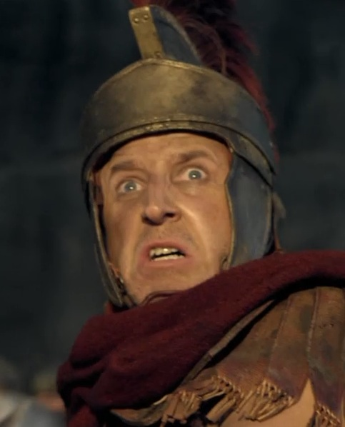
The Sack of Corinth
War between Rome and the Achaean League in 146 BCE
Sparta wished to leave the League; Rome gave permission, but the League attacked Sparta
The Romans entered the war on the side of Sparta and quickly defeated the League
Corinth was sacked by the Romans under Lucius Mummius and Greece lost its independence

Slide 18
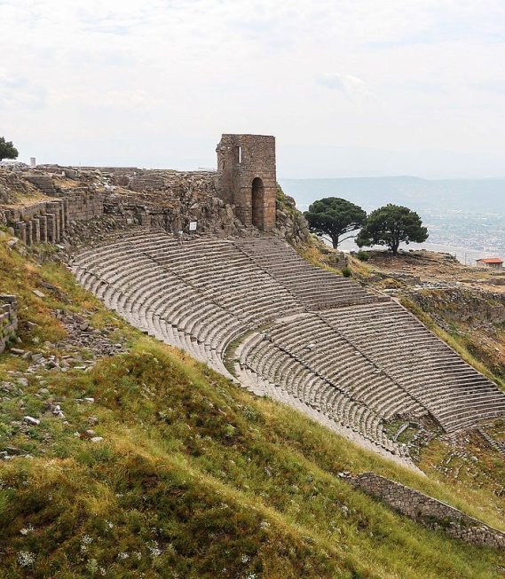
The Attalids
Kings of Pergamum in western Asia Minor
Frequent allies of Rome, but not always
When King Attalus III died in 133 BCE he left Pergamum and his kingdom to the Roman people
Had no heir

Slide 19
Hellenistic Kingdoms
Ptolemaic Kingdom
(Egypt)
Seleucid Empire
(Middle East)
Antigonids
(Macedonia)
Attalids
(Western Turkey)
Kings named ‘Ptolemy’
Kings named ‘Seleucus’ and ‘Antiochus’
Kings named ‘Philip’ and other things
Kings named ‘Eumenes’ and ‘Attalus’

Slide 20
The Antigonids
Antigonids
(Macedonia)
Rome encroached on Macedonia’s sphere of influence in Illyria
Defeated at Cynoscephalae in 197 and Pydna in 168 BCE
Kingdom broken up into republics
Kings named ‘Philip’ and other things

Slide 21
The Seleucids
Seleucid Empire
(Middle East)
Took in Hannibal in 195 BCE
Invaded Greece in 192; defeated by the Romans in 191
Romans invade Seleucid Asia Minor in 188
Seleucids are unable to oppose Rome after that
Kings named ‘Seleucus’ and ‘Antiochus’

Slide 22
The Attalids
Attalids
(Western Turkey)
Usually played other kings off against each other
Supported Rome when it was to their benefit
Attalus III bequeathed his kingdom to the Romans in 133 BCE
Kings named ‘Eumenes’ and ‘Attalus’

Slide 23
The Ptolemies
Ptolemaic Kingdom
(Egypt)
Minded their own business
Kings named ‘Ptolemy’

Slide 24
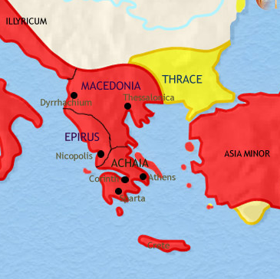
Provinces and Proconsuls
Formation of new provinces
Illyricum
Macedonia
Achaea
Asia
Development of new positions:
Proconsul
Propraetor

Slide 25
Key Terms
Illyria
Philip V
Cynoscephalae
Titus Quinctius Flamininus
Seleucids
Perseus
Pydna
Gaius Popillius Laenas
Judas Maccabbaeus
Delos
Lucius Mummius
Pergamum
Achaea
Proconsul

